Slide 1


2025 6th GLOBAL CONFERENCE FOR ADVANCEMENT IN TECHNOLOGY
(GCAT 2025)
Hybrid Deep Learning Model Using Residual Attention and Bilstm For Accurate Ischemic Heart Disease Classification
Paper ID: 2423
Bhavana Vatram
Narasaraopeta Engineering College

Slide 2
Introduction and Problem Statement
Ischemic Heart Disease Challenge
Traditional Methods Limitations : ECG, stress tests, and coronary angiography are expensive and not suitable for large-scale screening programs.
AI Solution Benefits: AI-driven technologies offer faster, scalable, and cost-effective diagnostic assistance for cardiovascular disease detection.
Research Objectives : Develop HRAE-LSTM model to address missing data, class imbalance, and feature scaling challenges in clinical datasets.

Slide 3
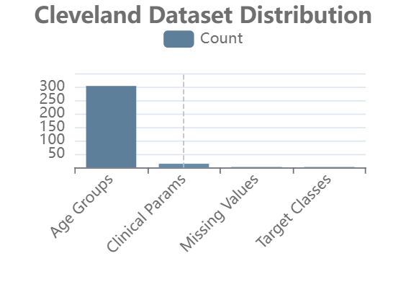
Dataset Information and Characteristics
Cleveland Heart Dataset
Contains 303 medical records with 14 clinical attributes including age, sex, blood pressure, cholesterol levels, and ECG data.
Clinical Parameters
Features include chest pain types, fasting glucose, maximum heart rate, exercise-induced angina, and coronary vessel data.

Slide 4
Data Preprocessing Pipeline
Exploratory Data Analysis : Performed comprehensive EDA to identify anomalies and outliers using boxplots and heatmaps for data quality assessment.
KNN Imputation : Applied K-Nearest Neighbors (k=5) to handle missing values in ‘thal' and 'ca' variables while preserving data relationships.
SMOTE-ENN Balancing : Used SMOTE-ENN technique to address class imbalance by generating synthetic samples and removing noisy data points.
Feature Scaling : Applied Standard Scaler to normalize features with mean=0 and standard deviation=1 for optimal LSTM training efficiency.

Slide 5
HRAE-LSTM Architecture Overview
Model Foundation : HRAE-LSTM combines Residual Attention mechanisms with Bidirectional LSTM to capture temporal dependencies and prioritize important clinical features for accurate IHD classification.
Residual Attention : Uses shortcut connections to retain essential information while enhancing discriminative features, ensuring important clinical parameters are prioritized without losing context.
Bidirectional LSTM : Learns sequential dependencies in both forward and backward directions, capturing intricate temporal relationships among clinical parameters.

Slide 6
Layer-by-Layer Architecture Details
Input Layer : Receives preprocessed clinical features after KNN imputation, SMOTE-ENN balancing, and standard scaling normalization.
Residual Attention Layers : Multiple attention layers with residual connections that enhance feature discrimination while preserving original signal information.
BILSTM Processing : Bidirectional LSTM captures temporal dependencies in both directions, learning complex patterns from clinical parameter sequences.

Slide 7
Model Training Process
Five-Fold Cross Validation : Dataset divided into 5 folds with each fold serving as test set once, ensuring robust model evaluation.
Early Stopping Mechanism : Training stops when validation accuracy shows no improvement for consecutive epochs, preventing overfitting and optimizing performance.
Dropout Regularization : Randomly drops neurons during training to reduce overfitting and improve model generalization on unseen data.

Slide 8
Dense Layers Configuration
Feature Integration
Dense Layer 1: Combines extracted features from BiLSTM layer and applies non-linear transformations for improved class separability.
Dense Layer 2: Further refines the feature representations and prepares them for final classification with additional non-linear mappings.
Output Layer: Uses Sigmoid Activation to compute IHD probability in range [0,1], where values near 1 indicate higher disease likelihood.

Slide 9
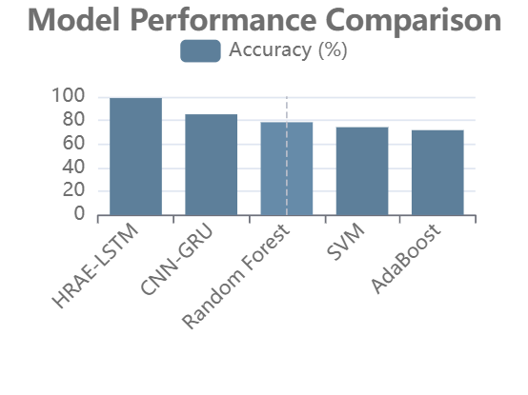
Results and Future Scope
Outstanding Results
HRAE-LSTM achieved 98.9% accuracy and perfect AUC score of 1.00, significantly outperforming traditional machine learning methods and other deep learning approaches.
Future: IoT wearable device integration for real-time monitoring
Future: Explainable AI frameworks (SHAP) for clinical applicability
Future: Federated learning for privacy-preserving collaborative diagnostics

Slide 10
Thank You..

